Slide 1
Ideas Worth Sharing
What’s for Dinner?
Student Needs and Opportunities
Child Nutrition Impact and Opportunities
Program Requirements
(Child and Adult Care Food Program)

Slide 2
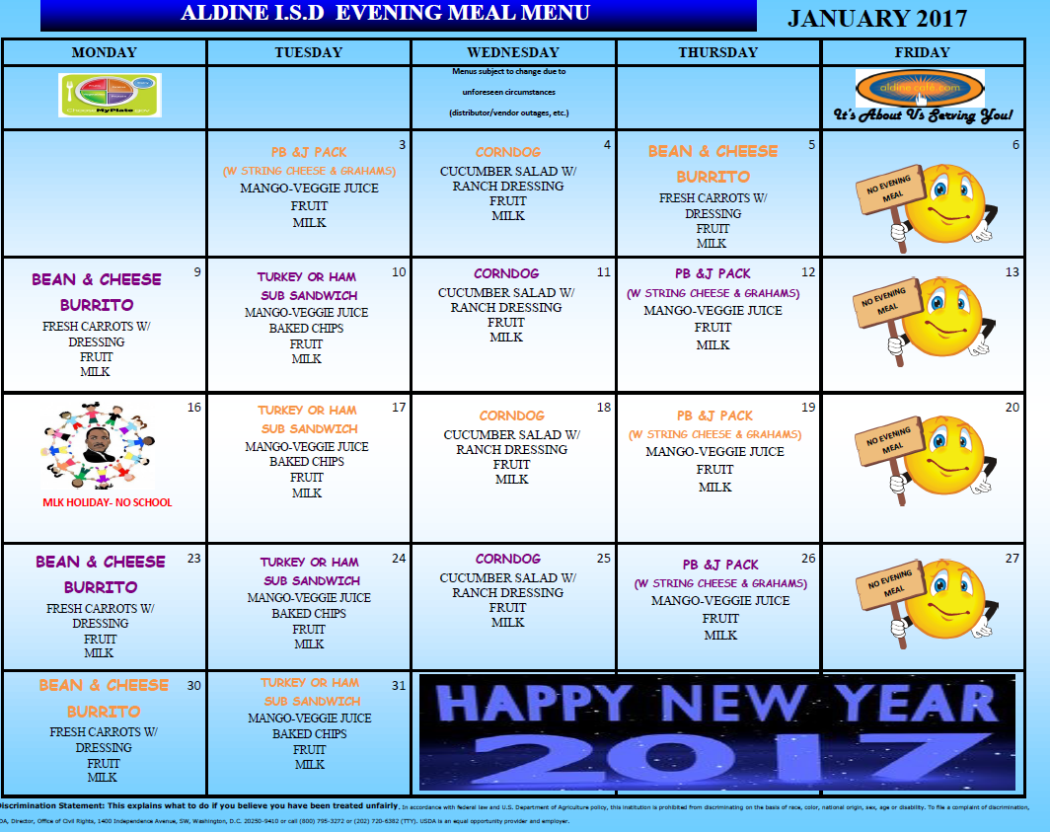
Menus
Service/Staffing
2500 – 3000 Meals Daily

Slide 3
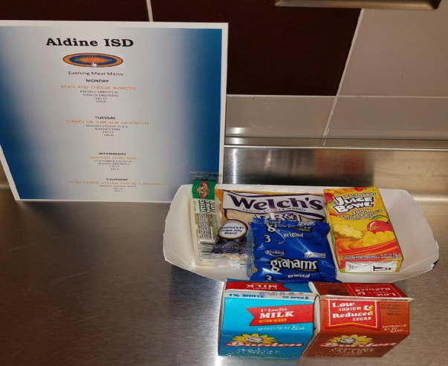
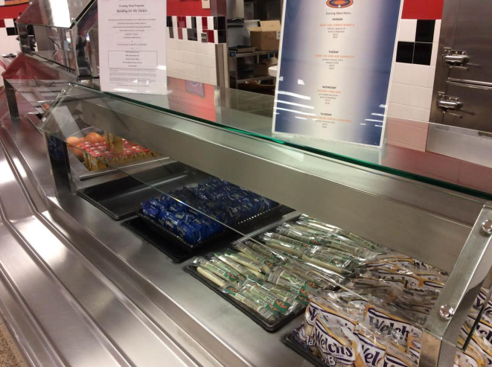
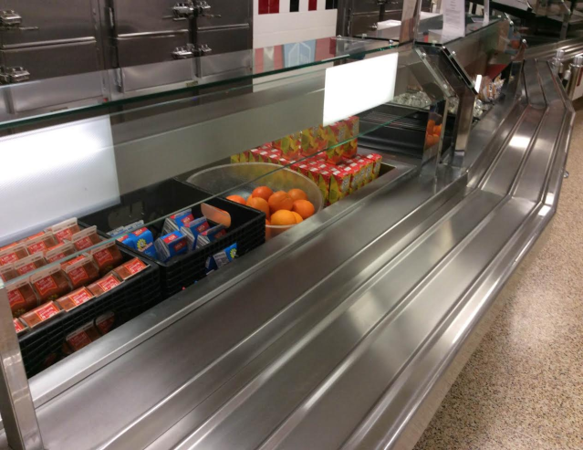
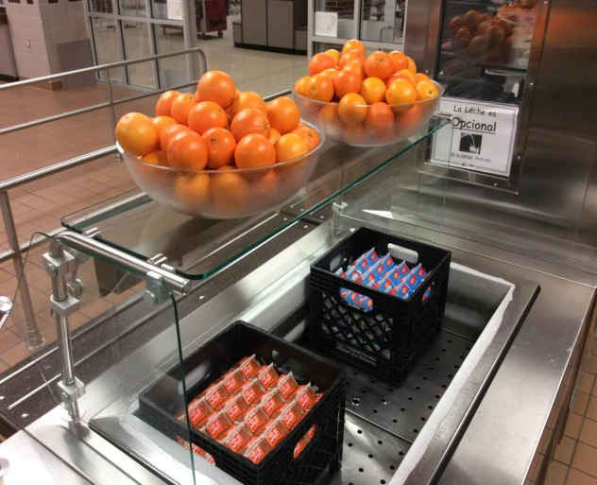
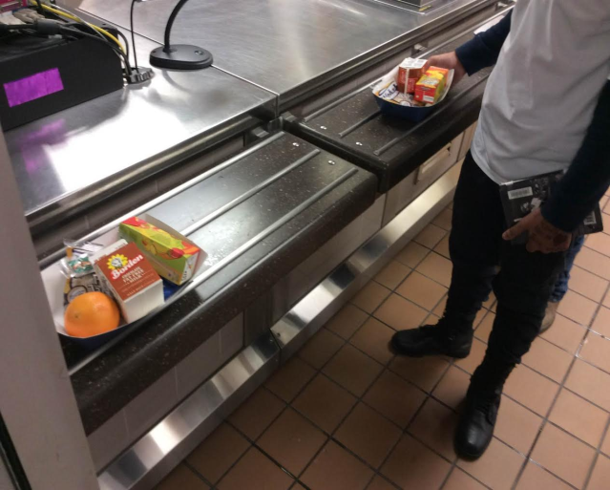
Dinner is Served
It’s About Us Serving You!

